Slide 1



Closing the Evidence-Practice Gap in Critical Care Nutrition
Naomi E Cahill RD PhD Candidate
Queen’s University, Kingston ON

Slide 2
Disclosures
None

Slide 3
Learning Objectives
  To identify gaps between guideline recommendations and current nutrition practices in ICUs throughout the World.
  To identify key barriers to the provision of adequate enteral nutrition in the ICU.
  To describe dissemination strategies for successful implementation of guideline recommendations at the bedside.

Slide 4
Outline
Evidence-Practice Gap
International Nutrition Survey 2011
Barriers Questionnaire
The PERFECTIS Study
Best of the Best Award

Slide 5
Evidence-Practice Gap
Suboptimal
Practice
Iatrogenic
Malnutrition
Clinical Trials
Guideline
Recommendations

Slide 6
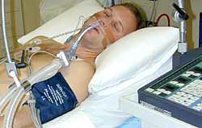
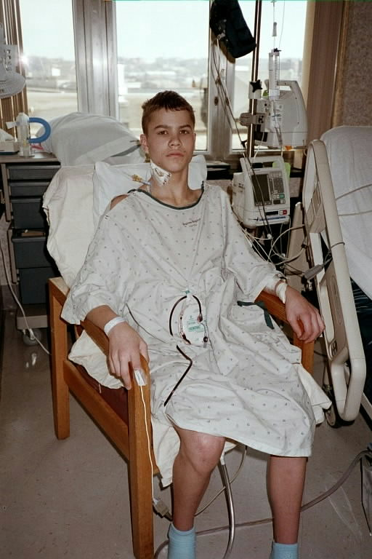

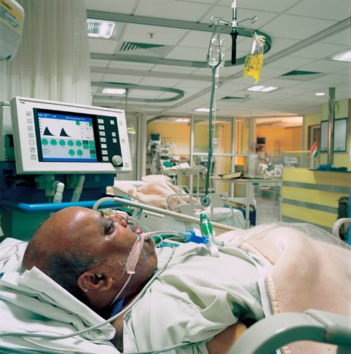

The provision of safe and adequate nutrition for all our critically ill patients

Slide 7
Evidence-Practice Gap
KT
QI
IS
Suboptimal
Practice
Iatrogenic
Malnutrition
Clinical Trials
Guideline
Recommendations

Slide 8

  Systematic review of effectiveness of guideline implementation strategies
  235 studies reporting 309 strategies
  86% of studies observed improvements in performance
    median effect of approx 10%
    Grimshaw et al Health Technol Assess 2004;8(6):1-72)

Slide 9


    Educational Meeting
    3 cluster RCTs
    Small effect

Slide 10
  Systematic review of effectiveness of guideline implementation strategies
  Effectiveness of interventions varies by
    Clinical problems
    Contexts
    Organizations
  Further research required
    Interventions informed by theoretical framework
    Consider barriers and effect modifiers
    Grimshaw et al Health Technol Assess 2004;8(6):1-72)

Slide 11
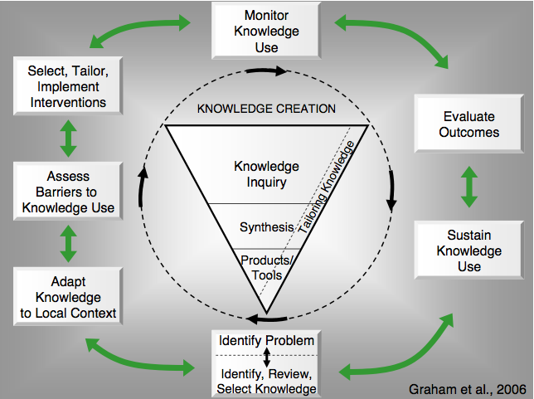
Knowledge-to-Action Framework
Template to guide implementation strategies
30 planned action theories
7 action phases

Slide 12
Defining the Gap
International audit of
nutrition practices
Graham et al 2006

Slide 13

International Nutrition Survey
Ongoing quality improvement initiative
Started in Canada in 2001
3 previous International surveys
355 ICUs from 33 countries

Slide 14

Methods
Observational study
Start date:11th May 2011
Aim 20 consecutive patients
  Min 8 pts
Data included:
  Hospital and ICU characteristics
  Patient information
  Baseline Nutrition Assessment
  Daily Nutrition data
  Patient outcomes (e.g. mortality, length of stay)

Slide 15

Who participated in 2011? :
221 ICUs
Canada: 24
USA: 47
Europe and Africa: 26
Asia: 52
China: 19
Taiwan: 9
India: 9
Iran : 1
Japan: 9
Singapore: 3
Philippines:1
Thailand: 1
Italy: 2
UK: 8
Ireland: 6
Norway: 5
Switzerland: 1
France: 1
Spain: 2
South Africa: 1
Argentina: 5
Chile: 3
El Salvador:1
Mexico: 2
Brazil:4
Colombia:9
Peru:1
Venezuela:2
Uruguay:4
Latin America: 31
Australia & New Zealand: 41
Notes:
Please verify these numbers are accurate
Done - MW

Slide 16
ICU Characteristics
Characteristics | Total (n=183)
Hospital Type
Teaching | 142(77.6%)
Non-teaching | 41 (22.4%)
Size of Hospital (beds)
Mean (Range) | 641 (100-2600)
ICU Structure
Open | 47 (25.7%)
Closed | 132 (72.1%)
Other | 4 (2.2%)
Size of ICU (beds)
Mean (Range) | 18 (5-65)
Designated Medical Director | 172 (94.0%)
Presence of Dietitian(s) | 145 (79.2%)
FTE Dietitians (per 10 beds)
Mean (Range) | 0.6 (0.0-27.8)
Notes:
Yes, fill in table

Slide 17
Patient Characteristics
Characteristics | Total n=3695
Age (years)
Median [Q1,Q3] | 63 [50, 74]
Sex
Female | 1495(40.5%)
Male | 2197(59.5%)
Admission Category
Medical | 2316(62.7%)
Surgical: Elective | 486(13.2%)
Surgical: Emergency | 893(24.2%)
BMI (kg|m2)
Median [Q1, Q3] | 25.4 [22.2, 29.8]
Apache II Score
Median [Q1, Q3] | 21[16, 27]
Presence of ARDS
Yes | 324(8.8%)

Slide 18
Outcomes at 60 days
Characteristics | Total n=3695
Length of Mechanical Ventilation (days)
Median [Q1, Q3] | 6.8 [3.4, 13.8]
Length of ICU Stay (days)
Median [Q1, Q3] | 9.9 [5.9, 18.0]
Length of Hospital Stay (days)
Median [Q1,Q3] | 19.2[10.8, 37.0]
Patient Died (within 60 days)
Yes | 906(24.5%)

Slide 19
Type of Artificial Nutrition
We strongly recommend the use of enteral nutrition over parenteral nutrition

Slide 20
Use of Enteral Nutrition Only
n=35054 patients days

Slide 21
Timing of Initiation of Enteral Nutrition
We recommend early enteral nutrition (within 24-48 hrs following admission) in critically ill patients

Slide 22
Use of a Feeding Protocol
Characteristics | Total n=183
Feeding Protocol
Yes | 148 (80.9%)
Gastric Residual VolumeThreshold
Mean (range) | 264(100, 500)
Algorithms included in Protocol
Motility agents | 116(63.4%)
Small bowel feeding | 90(49.2%)
Withholding for procedures | 82(44.8%)
HOB Elevation | 121(66.1%)
An evidence based feeding protocol should be considered as a strategy to optimize delivery of enteral nutrition

Slide 23
Motility Agents
In critically ill patients who experience feed intolerance (high gastric residual volumes, emesis) the use of a motility agent and small bowel feeding tubes are recommended

Slide 24
Small Bowel Feeding
In critically ill patients who experience feed intolerance (high gastric residual volumes, emesis) the use of a motility agent and small bowel feeding tubes are recommended

Slide 25
Use of EN Formula and Pharmaconutrients
Arginine-supplemented formulas | 4.9%(0.0%-72.2%)
Glutamine enriched formula (All) | 0.8%(0.0%-43.8%)
Fish oil enriched formula (ARDS) | 12.8% (0.0%-100.0%)
Polymeric | 83.0% (0.0%-100.%)
Notes:
Please double check data

Slide 26
Blood Glucose Control
We recommend that hyperglycemia
(blood sugars >10mmol/l)
be avoided

Slide 27
Overall Performance
The proportion of prescribed calories received

Slide 28
Benchmarking
Individual ICUs compared to:
Canadian Clinical Practice Guidelines
All ICUs
ICUs from same geographic region
Individual ICUs compared to:
Canadian Clinical Practice Guidelines
All ICUs
ICUs from same geographic region

Slide 29
Opportunities for Change
Failure Rate:
% patients who failed to meet minimal quality targets (80% overall energy adequacy)

Slide 30
Barriers Assessment
Graham et al 2006

Slide 31
Framework for understanding barriers to guideline adherence
CLINICAL
PRACTICE
GUIDELINE
ADHERENCE
Guideline
Characteristics
Patient Characteristics
Implementation Process
Institutional
Characteristics
Provider Intent
Provider Characteristics
Hospital and ICU Structure
Knowledge
Attitudes
Hospital Processes
Resources
Familiarity
Agreement
Outcome
expectancy
ICU Culture
Awareness
Motivation
Self-efficacy
Legend: Ovals = Theme, Boxes = Factors, Italics = New themes/factors, ICU = Intensive Care Unit
Cahill N et al JPEN 2010
Notes:
Don’t’ spend a lot of time with this.

Slide 32

Barriers Questionnaire
Part of International Nutrition Survey 2011
Distributed to all ICU staff
Online or paper-based
Part A
  26 items
  Focus on modifiable barriers
  Rate importance of items as barriers
  to providing adequate EN
Part B
  Personal demographics
Barriers Score calculated

Slide 33
Barriers Results
ICU Characteristics | Total (n=70)
Hospital Type
Teaching | 48(68.6%)
Non-teaching | 22 (31.4%)
Size of Hospital (beds)
Mean (Range) | 517 (109-2000)
ICU Structure
Open | 18 (25.7%)
Closed | 51 (72.9%)
Other | 1 (1.4%)
Size of ICU (beds)
Mean (Range) | 18 (4-65)
Designated Medical Director | 66 (91.4%)
Presence of Dietitian(s) | 64 (91.4%)
FTE Dietitians (per 10 beds)
Mean (Range) | 0.52 (0-6)
Notes:
Yes, fill in table

Slide 34
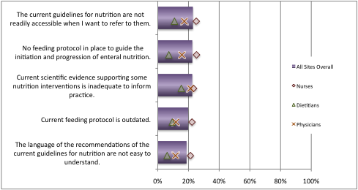
Guideline Recommendations & Implementation

Slide 35
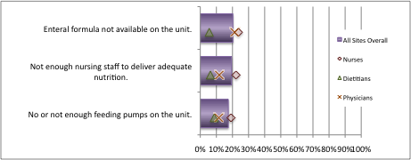
ICU Resources

Slide 36
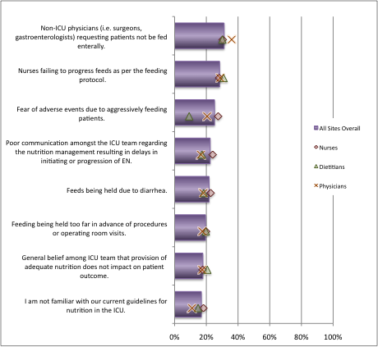
Critical Care Provider Attitudes & Behaviour

Slide 37
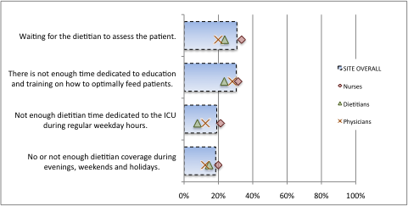
Dietitian Support

Slide 38
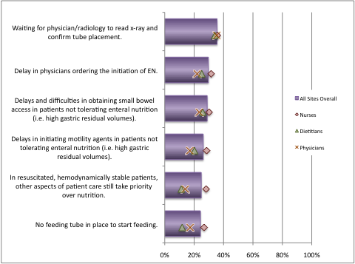
Delivery of EN to the Patient

Slide 39
Top 5 Ranked Barriers
1 Delays and difficulties in obtaining small bowel access in patients not tolerating enteral nutrition (i.e. high gastric residual volumes).
2 Non-ICU physicians (i.e. surgeons, gastroenterologists) requesting patients not be fed enterally.
3 No or not enough dietitian coverage during evenings, weekends and holidays.
4 There is not enough time dedicated to education and training on how to optimally feed patients.
5 Delay in physicians ordering the initiation of EN.

Slide 40
Tailored Intervention
Tailored Intervention:
Change strategies specifically chosen to address the barriers identified at a specific setting at a specific time
Graham et al 2006

Slide 41
Guideline Implementation Studies in Critical Care Nutrition
Three Cluster RCTs conducted to date:
  Martin et al CMAJ 2004
  Jain et al Crit Care Med 2006
  Doig et al JAMA 2008
  Multi-faceted strategies
  Mixed results

Slide 42


Systematic Review of Tailored Interventions
26 studies of tailored interventions
Pooled OR 1.52 (95% CI 1.27-1.82), p=0.001
Variation in methodology
Baker et al Cochrane Database Syst Rev 2010

Slide 43
PERFormance Enhancement of the Canadian nutrition guidelines through a Tailored Implementation Strategy: The PERFECTIS Study
To conduct a cluster Randomized Controlled Trial to evaluate the effectiveness of Tailored Implementation Strategies to overcome barriers to adherence of recommendations of critical care nutrition guidelines.
First evaluate if tailored guideline implementation is feasible: The PERFECTIS Study
  Do barriers to enterally feeding patients differ across ICUs?
  Does each individual ICU require a unique action plan?
  Are ICUs able to implement the action plan?

Slide 44
PERFormance Enhancement of the Canadian nutrition guidelines through a Tailored Implementation Strategy: The PERFECTIS Study
7 Study ICUs from 5 Hospitals in Canada and US
Tailored
Action Plan
12 months
3 months
Screening
Evaluation
Nutrition Practice Audit
Barriers Assessment
Nutrition Practice Audit
Barriers Assessment
Identify guideline-practice gaps
Identify barriers to change

Slide 45
Participating ICUs (n=7)
ICU # | Country | Hospital Type | Hospital Size | ICU Structure | ICU Size
1 | Canada | Teaching | 650 | Closed | 30
2 | Canada | Teaching | 933 | Closed | 25
3 | USA | Non-Teaching | 261 | Closed | 27
4-6 | USA | Teaching | 600 | Open | 10-12
7 | Canada | Non-Teaching | 400 | Open | 13

Slide 46
Tailored Action Plan Development: Step 1
Identify evidence-practice gap to target for change

Slide 47
Tailored Action Plan Development: Step 2
Prioritized Barrier | Potential Action | Feasibility Score+ | Impact Score* | Priority score # | Select for Action
e.g. Delay in physicians ordering EN | Educational sessions | 4 | 2 | 8 | Yes
 | Add initiation of EN to the daily rounds checklist | 2 | 4 | 8 | Yes
 | Implement a pre-printed order form instead of writing in chart | 2 | 3 | 6 | No
Brainstorm and identify potential change strategies to overcome barriers
  Feasibility and impact in local context
  Potential for success
Notes:
Step 2
Brainstorm and identify potential change strategies to overcome barriers
Consider
Feasibility and impact in local context
Potential for success

Slide 48
Tailored Action Plan Development:
Step 3
Identify team member to lead the change
Agree on how change/adherence will be measured
Agree on timeline for implementation and reassessment

Slide 49
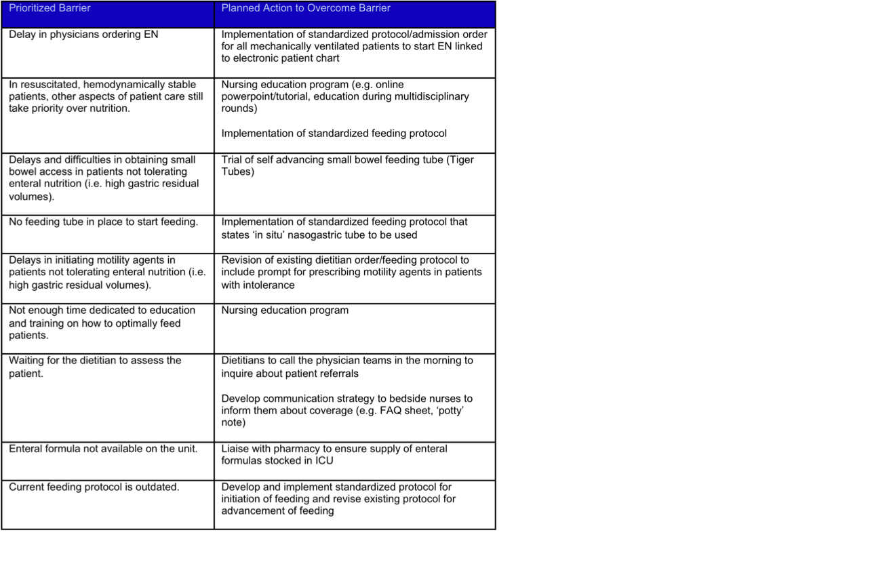
Action Plan Example

Slide 50
Monthly Progress Report

Slide 51
PERFECTIS Results
  Do barriers to enterally feeding patients differ across ICUs?
  Yes, significant differences in barriers related to delivery of EN (p = 0.02) and ICU resources (p<0.01)
  Does each individual ICU require a unique action plan?
  Yes, action plans differed across sites
  Some common elements but operationalized differently
    Feeding Protocol
    Education sessions
Are ICUs able to implement the action plans
  Yes, no attrition
  I site (3 ICUs) unable to implement key elements of the action plan during the study period due to unmodifiable barriers
Notes:
Do barriers to enterally feeding patients differ across ICUs?
Are ICUs able to implement the action plan?

Slide 52
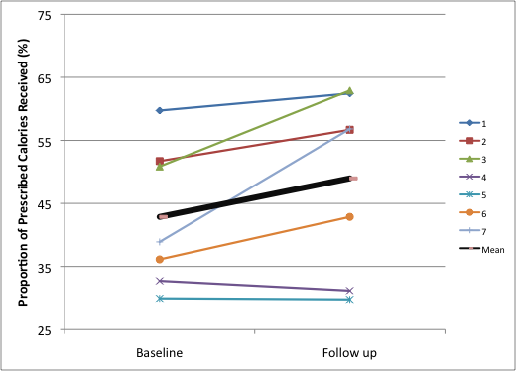
PERFECTIS Results
Change in Nutritional Adequacy
17.9%
6.1%
-1.6%
Notes:
Highlight changes 43 – 49%

Slide 53
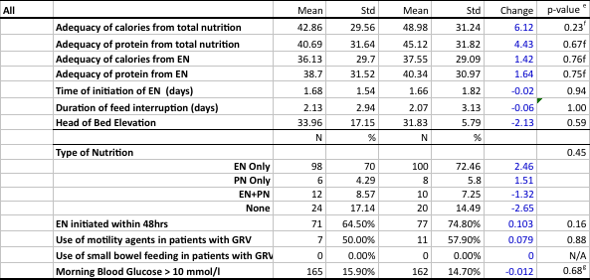
PERFECTIS Results
Notes:
43 - 49

Slide 54
PERFECTIS Conclusions
Support rationale for tailored approach to guideline implementation
The development, implementation, and evaluation of tailored action plans is feasible in ICUs
The effectiveness of tailored guideline implementation strategies in improving nutrition practice is to be determined
Notes:
43 - 49

Slide 55
Learning Assessment ….. Task
  Identify gaps between guideline recommendations and current nutrition practices in your ICU/hospital or new evidence that you wish to translate
  Determine the barriers to changing practice in your ICU/hospital
  List potential strategies to implementation the change in practice in your ICU/hospital
Make the Change……

Slide 56
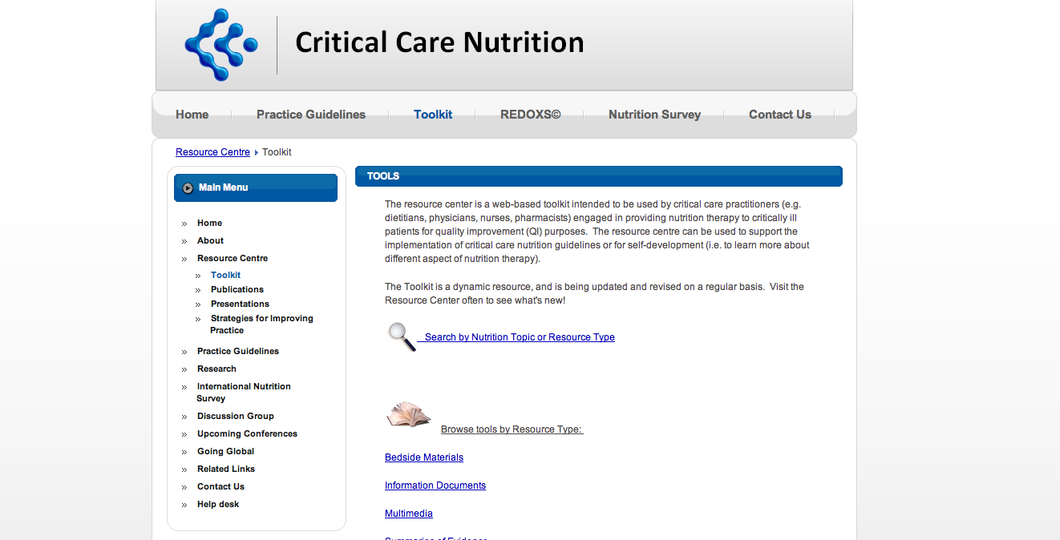

Slide 57

Creating a Culture of Excellence in Critical Care Nutrition
The Best of the Best Award 2011

Slide 58
Best of the Best Award
Eligible sites:
  Data on 20 critically ill patients
  Complete baseline nutrition assessment
  Presence of feeding protocol
  No missing data or outstanding queries
  Permit source verification by CCN
Ranked based on performance on 5 criteria:
  Adequacy of provision of energy
  Use of enteral nutrition (EN)
  Early initiation of EN
  Use of promotility drugs and small bowel feeding tubes
  Adequate glycemic control

Slide 59


2009 Best of the Best Awardees
Of >200 ICUS competing Internationally
1. Instituto Neurologico de Antioquia, Medellin, Colombia
1. Royal Prince Alfred Hospital, Sydney, Australia
1. The Alfred, Melbourne, Australia
Notes:
Need to add sites when known. Add ASPEN logo

Slide 60
2011 Best of the Best
Honourable Mention
Tri-Service Hospital MICU, Taipei, TW
Regina General Hospital MPICU, Regina, CA
MPICU APOLLO SPECIALITY HOSPITAL CRITICAL CARE UNIT, CHENNAI, IN
Pasqua Hospital ICU, CA
Royal Melbourne Hospital RMH ICU, Melbourne, AU

Slide 61
2011 Best of the Best
Top 10
4. Beaumont Hospital Richmond ITU, Dublin, IE
5. Sunnybrook Health Sciences Centre CrCU, Toronto, CA
6. APOLLO HOSPITALS CRITICAL CARE UNIT, CHENNAI, IN
7. Apollo Speciality Hospitals INTENSIVE CARE UNIT, Madurai, IN
8. AMRI Hospitals AMRI MITU, Kolkata, IN
9. Beaumont Hospital General ICU, Dublin, IE
9. Hospital Nacional Guillermo Almenara Irigoyen D. Cuidados Criticos, Lima, PE

Slide 62

2011 Best of the Best
Winners
The Alfred The Alfred ICU, Melbourne, AU
Gold Coast Health Services District General Adult ICU, Gold Coast, AU
Trillium Health Centre ICU, Mississauga, CA

